Slide 1
Music Database
Alex DeFiore | Adam DeFranco
Zach Jaffee | Daniel McKinnon

Slide 2

Application Background
Large database of music
To be used for radio hosting
References music by artist, albums, and track names

Slide 3
Data Generated
Randomly generated content
Selenium Webdriver
Generated unique artist/album/track keys
Songname.net
Examples:

Slide 4
ER Diagram
Track_Name
Track_ID
Album_Name
NumAlbumTracks
Track
Is in
Album
Album_ID
Year
has an
By
Artist
Artist_ID
Artist_Name
Num_Albums
numArtistTracks

Slide 5
Constraints
Key Constraints:
Track is in one album
Track has one artist
Participation Constraints:
Track to album | album to track
Track to artist | artist to track
Album to artist | artist to album

Slide 6
Implementation
Programming Language
Java
Database Management System
MySQL
Operating System
Windows 7

Slide 7
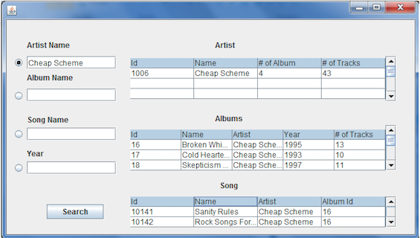
Example Query – Artist Search

Slide 8
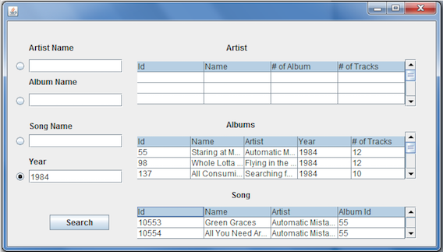
Example Query – Year Search

Slide 9


